Slide 1
Security and Privacy of Smart Devices Yinhao Xiao
Committee:
Xiuzhen Cheng
Hyeong-Ah Choi
Arkady Yerukhimovich
Xiang Chen

Slide 2
CONTENTS
01
02
03
04
Smartphone Security & Privacy
Smart Home Devices Security & Privacy
Conclusion
Background

Slide 3
CONTENTS
02
03
04
01
Background
Smartphone
Security & Privacy
Smart Home Devices
Security & Privacy
Conclusion

Slide 4

What Are Smart Devices?
Smart devices are electronic devices that are connected to each other and to the servers via different wireless protocols.
https://en.wikipedia.org/wiki/Smart_device

Slide 5

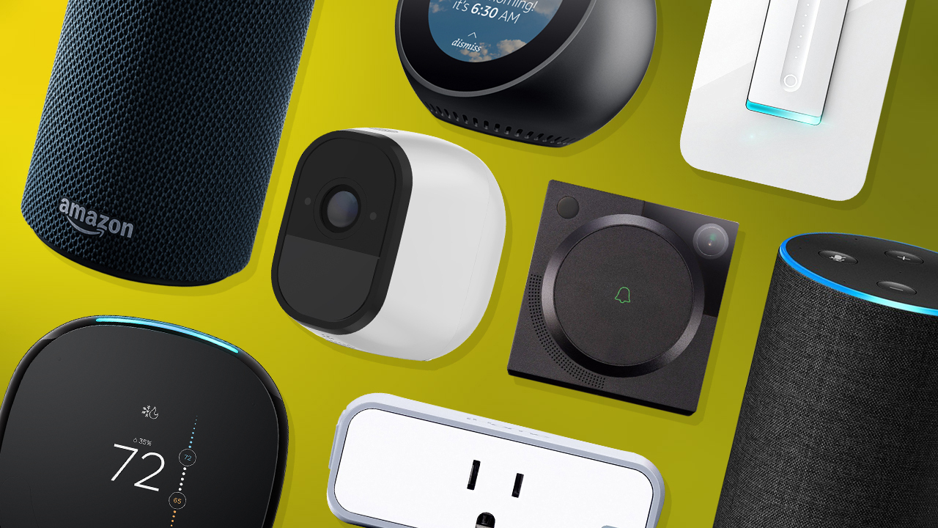
What Are Smart Devices?
Smart Devices
Smartphones
Smart Home Devices
Notes:
https://www.techhive.com/article/3253952/home-tech/best-alexa-smart-home-devices.html
https://www.youtube.com/watch?v=FEr9D2glDXA

Slide 6
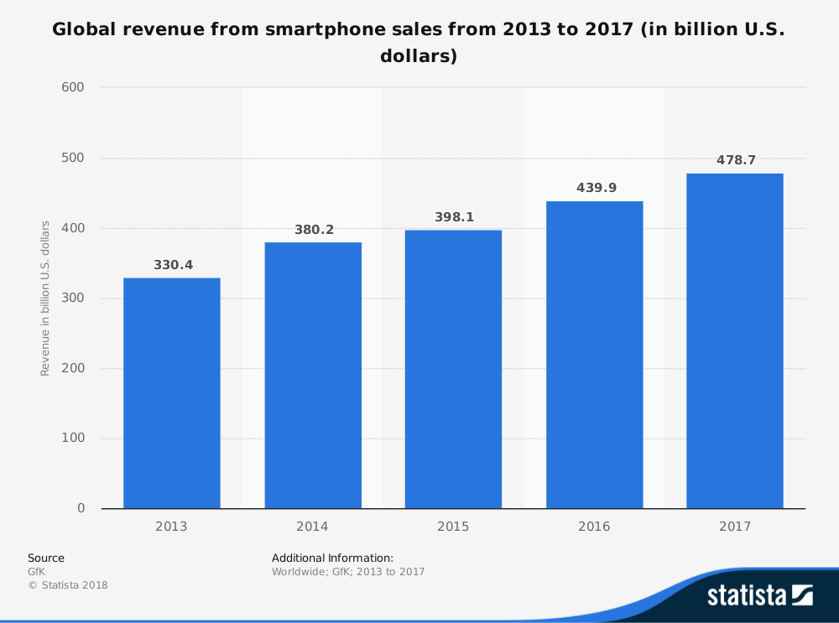
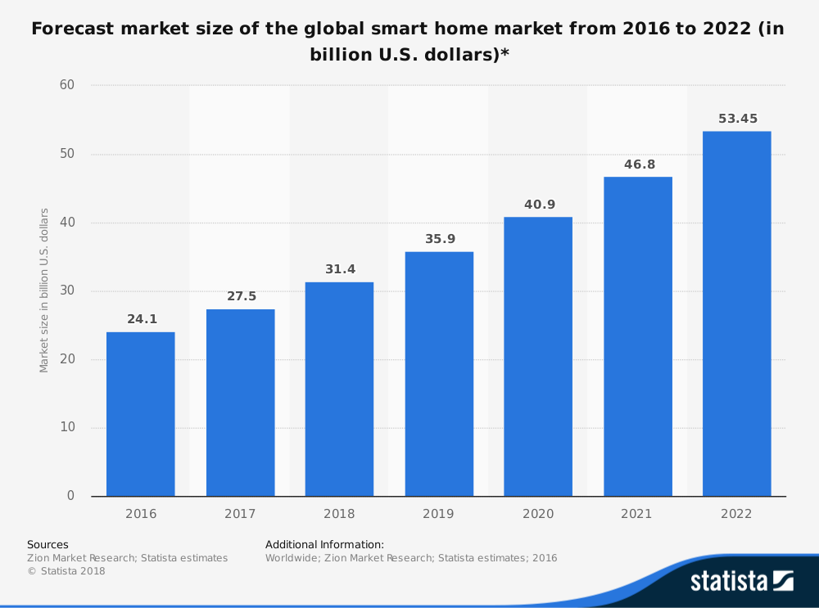
The Market of Smart Devices
https://www.statista.com/statistics/237505/global-revenue-from-smartphones-since-2008/
https://www.statista.com/statistics/682204/global-smart-home-market-size/

Slide 7
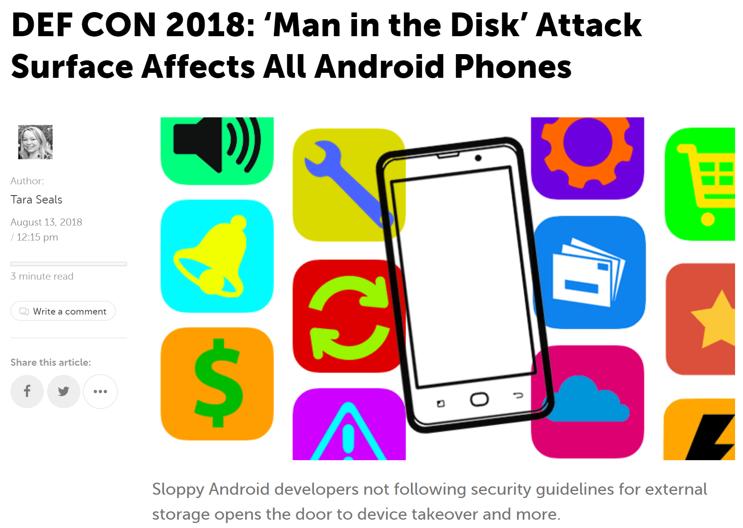
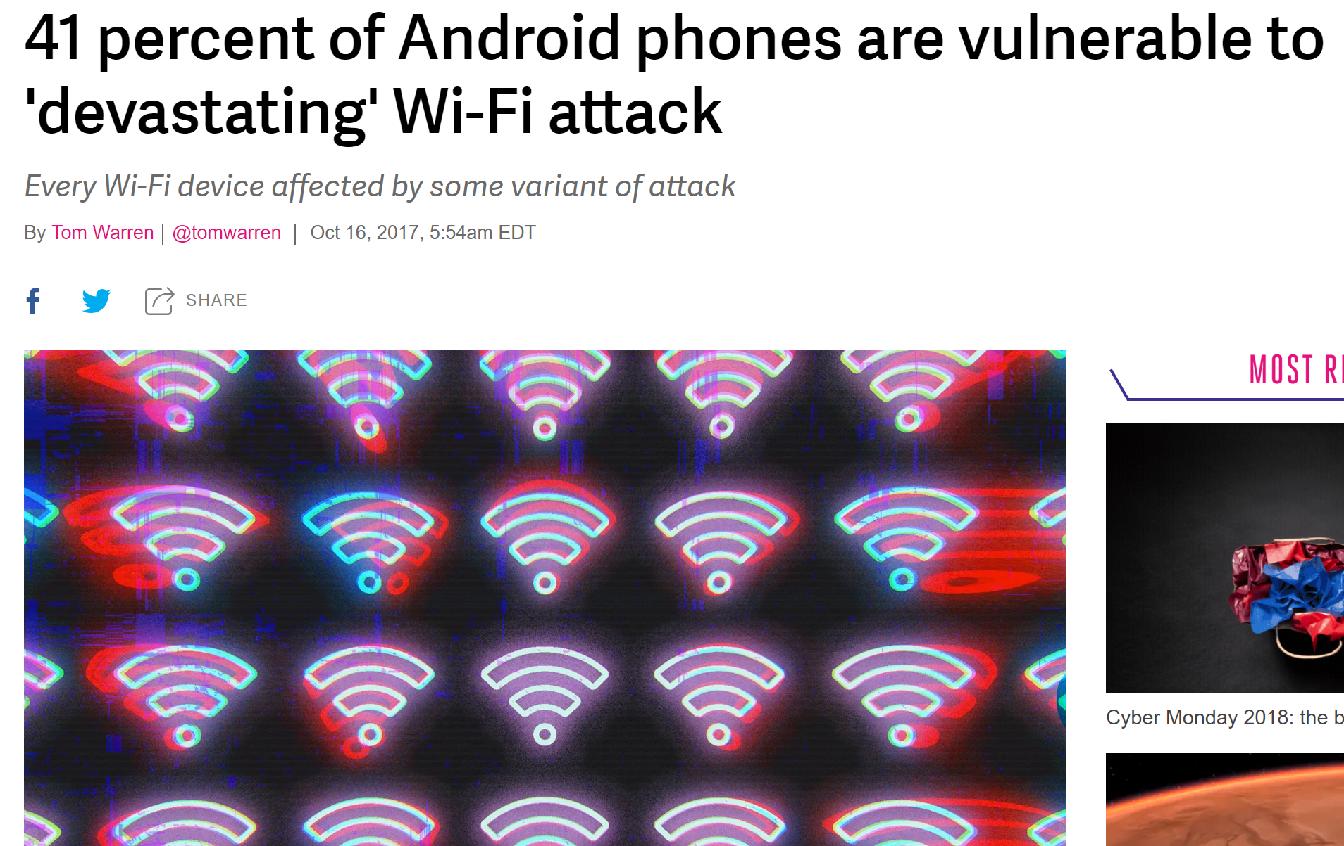
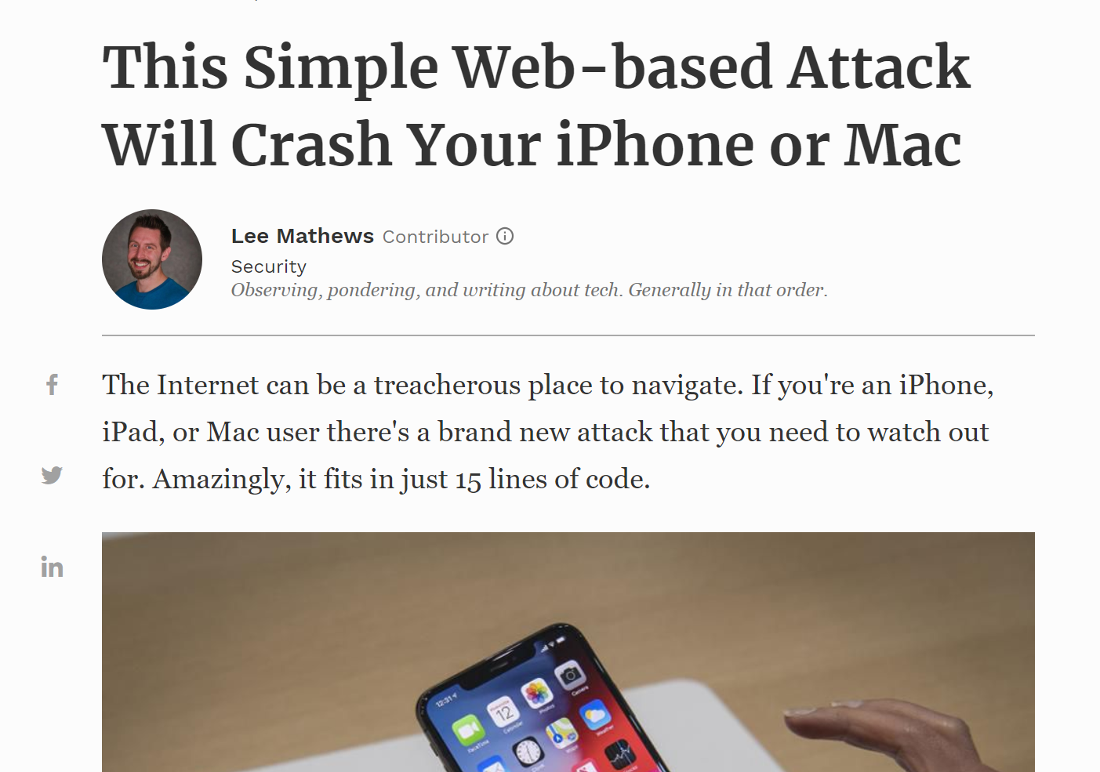
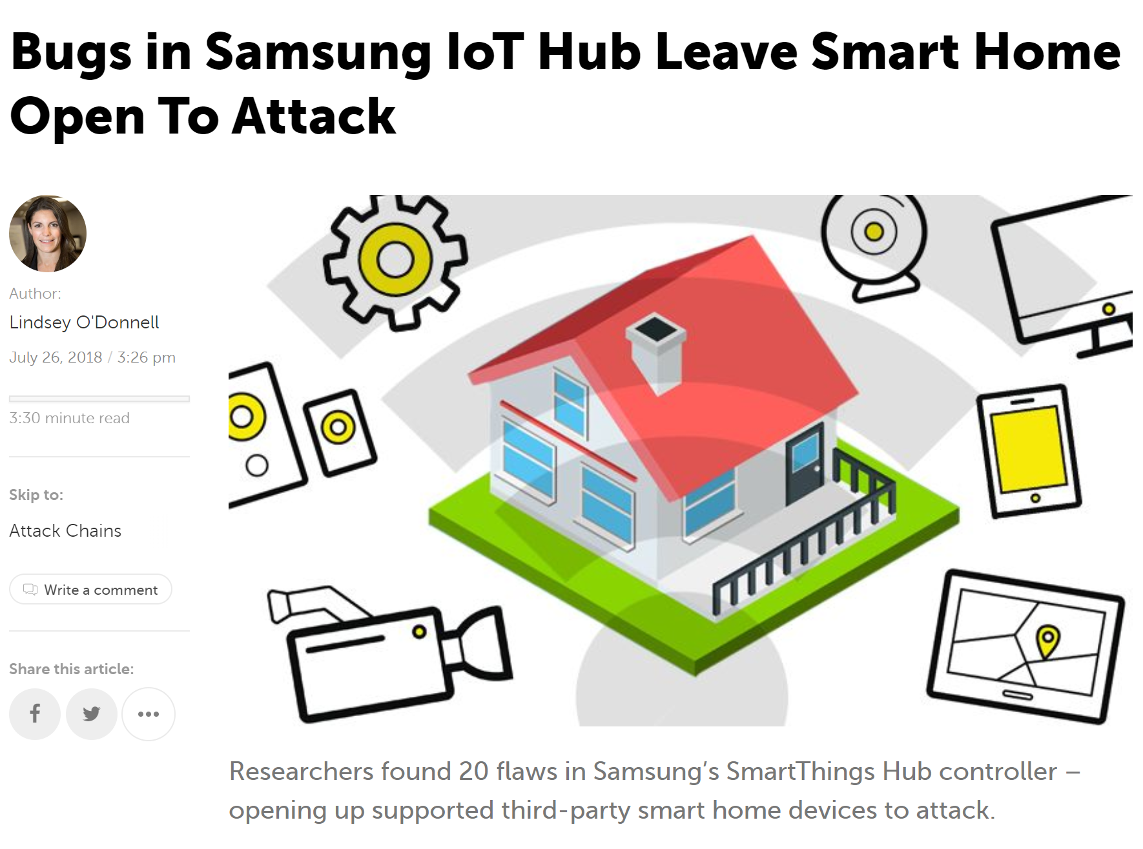
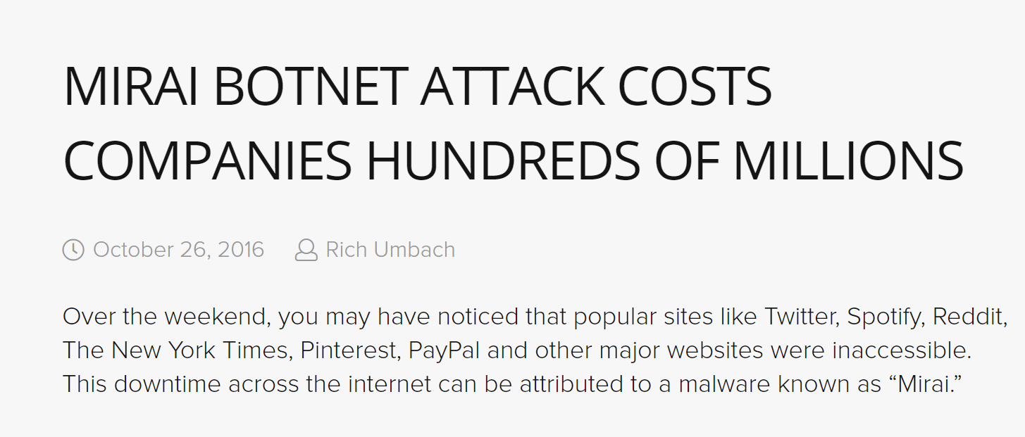
The Security of Smart Devices is Concerning
Why can’t we apply traditional desktop protective mechanisms to smart devices?

Slide 8
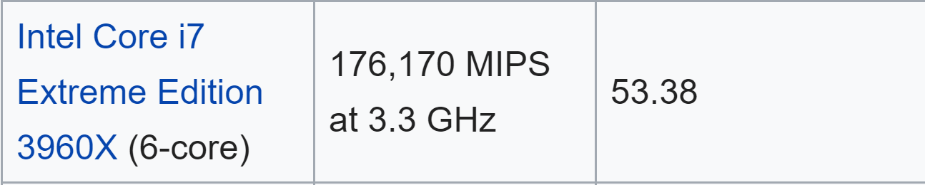
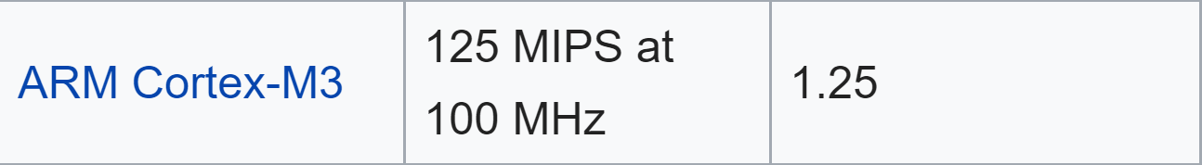






Challenges
Smart devices are computationally limited for powerful firewalls.
The OS/firmware of smart devices are quite different from those of desktops.
Complicated attack vectors.
https://en.wikipedia.org/wiki/Instructions_per_second
VS

Slide 9
Contributions
In this proposal, we:
Study security/privacy issues of Android from OS perspective
Identify new design flaw in Android Task Mechanism
Implement four novel attacks exploiting the flaw
Develop defense mechanism to eliminate the threat
Study security/privacy issues of Android Side-Channel Information
Correlate Android side channels with social network events
Infer user’s identity based on the events with 96.81% accuracy

Slide 10
CONTENTS
02
03
04
01
Background
Attacking
Android OS
Exploiting
Android Side-Channel
Conclusion and
Future Study

Slide 11
Privilege Leakage and Information Stealing through the Android Task Mechanism

Slide 12
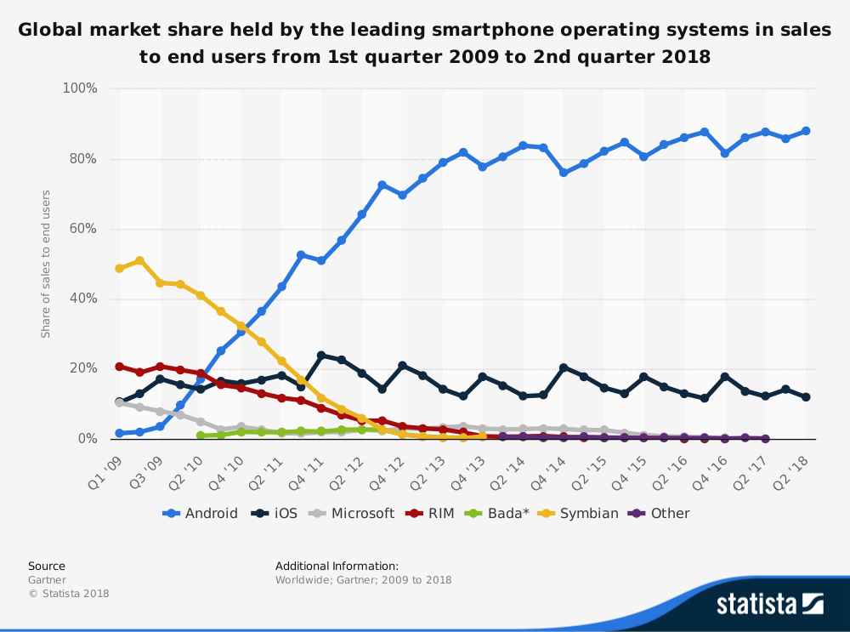

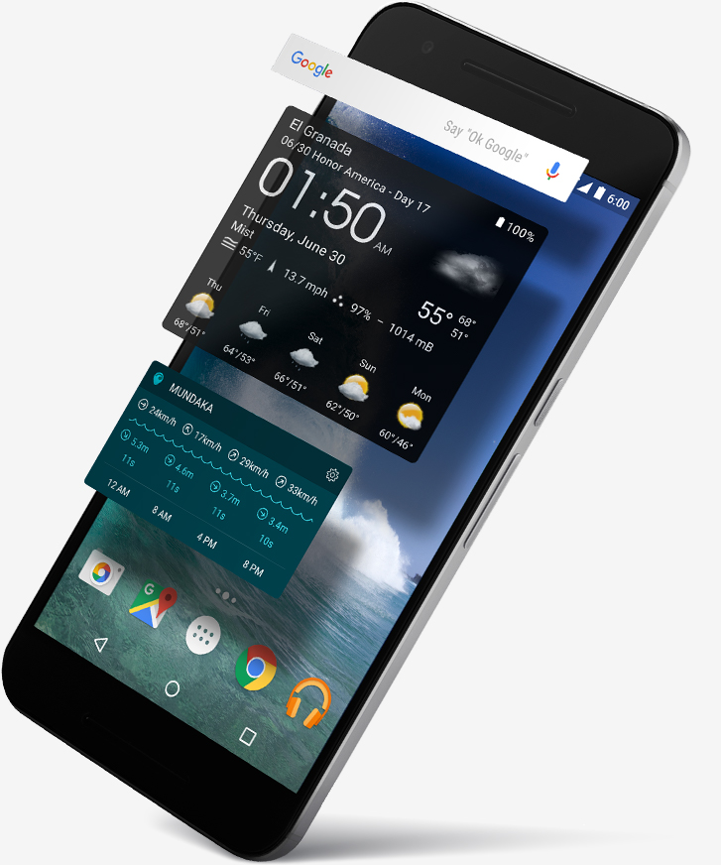



Why Android?
https://www-statista-com.proxygw.wrlc.org/statistics/266136/global-market-share-held-by-smartphone-operating-systems/

Slide 13
Android App Isolation
Android adopts an isolation-based security mechanism
Isolation between apps
Controlled inter-app communication through specific interface.
App_A
App_B
Content Provider
Content Provider
Resources
Resources
Permissions
Permissions
Strong isolation may hinder benign apps from communicating and collaborating with one another effectively
Notes:
Android is the most popular mobile operating system compared to others these days. Having said that, if security breach happens in Android system, it can pose a great harm and cause significant damage to users privacy. The existence of malicious Apps by so far is the most serious security concern. Therefore, like most other modern OSes, Android adopts an isolation-based security mechanism. It means each app are placed into different isolations to begin with. Here’s an example. Suppose we have an Application A and Application B, they are placed into two isolations by the system. Each of them has their own resources and permissions granted to them. They are assigned to different memory pages and cannot interfere with each other. Traditionally, if Application B wants to access the resources of Application A, it has to request the content provider customized by A, and content provider of A will decide whether the requested resource is shareable, if it is, content provider will retrieve the resource and pass to B. However, such strong isolation mechanism is sometimes inefficient and can sometimes hinder benign apps from communicating and collaborating with one another effectively. In order to resolve this problem, Android proposed a unique inter-app corporation structure called Android task mechanism.

Slide 14
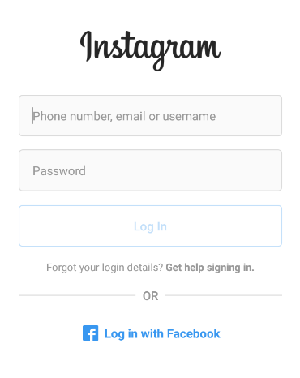


App Interaction
Users prefer seamless Activity (UI pages) connection even if two apps are isolated.
Instagram
ID@facebook
Facebook
*********
Notes:
According to Android official documentation, a task is a collection of Activities that users interact to perform a certain job. These Activities are arranged in a stack called back stack. Android task mechanism is designed for facilitating inter-app communication and for better support app collaborating under same tasks. If different Apps want to accomplish a same job, they can put some of their Activities in a same task as if they are operated in the same App. This design can not only make the inter-app collaboration faster but also reduce memory usage.

Slide 15
Android Task Mechanism
A task is a collection of Activities that users interact to perform a certain job.
Activities are arranged in a stack called back stack.
Instagram
ID@facebook
Facebook
*********
Back Stack
Notes:
According to Android official documentation, a task is a collection of Activities that users interact to perform a certain job. These Activities are arranged in a stack called back stack. Android task mechanism is designed for facilitating inter-app communication and for better support app collaborating under same tasks. If different Apps want to accomplish a same job, they can put some of their Activities in a same task as if they are operated in the same App. This design can not only make the inter-app collaboration faster but also reduce memory usage.
Let’s take a look at a real-world example. Suppose you are a first time user of Instagram, you will have to first login to Instagram before you can proceed to view the posts in Instagram. In the LogingActivity of Instagram, you can actually choose to login with your Facebook account. If you choose this option, you will see the UI changes to Facebook LoginActivity which is implemented in the Facebook App. However, they actually reside in a same task. After you login to Facebook, then the UI changes back to ViewPostActivity in Instagram where you can view all the posts now. In this case, these three Activities reside in a same task or back stack even though they are from different Apps. Here are the real figures. As we can see, even if Facebook LoginActivity shows up, there is only one Task when you pressed the “recents” button.

Slide 16
Privacy Concerns of Android Task Mechanism
Task mechanism relaxes the isolation provided by the Android system and could grant unexpected over-permissive privilege to apps.
What if a malicious app gets into same task of a benign App?
Ren et al. [USENIXSEC15’ Task] demonstrates the attack vectors of passive task hijacking which can result in spoofing and phishing.
Notes:
On one hand, Android task mechanism provides a more flexible and convenient inter-app collaboration environment, on the other hand, however, it also leaves privacy concerns due to the relaxation of the isolation enforcement. Relaxation of the isolation enforcement can often cause unexpected over-permissive privilege to other apps. Changang Ren et al. conducted the first security study towards Android task mechanism and found passive attack vectors related to task hijacking are possible which can result in spoofing and phishing.

Slide 17
Our Goal
Comprehensive study understanding of task mechanism.
Mission 1:
Understanding Task Control
Mission 4:
Task Interference Checking
Mission 2:
Understanding Task Privilege
Mission 3:
Exploitation Analysis

Slide 18
M1: Understanding Android Task Mechanism
What factors affects an app’s task status?
How these factors affects app’s task status?
Whether an app is running in the foreground or background?
Which is the resulting task state of the app?

Slide 19
Key Attributes of Task Mechanism
launchMode
Decides how an activity will be launched
Has four values: standard, singleTop, singleTask and singleInstance.
taskAffinity
Specifies which task the activity should be affiliated with.
By default, it is the package name of the activity itself.
allowTaskReparenting
Specifies whether an activity can be moved to a task which has the same taskAffinity.

Slide 20
Control Conditions of Task Mechanism
Experiment Targets:
App_B
App_M
①Initial Conditions Settings
②Events
③Resulting States
Dynamic testing for possible key attribute (value) combinations of two app templates
How App_B and App_M will be launched
(launching order )
(who launches who)
Which App is in the foreground
whether they are in the same task
Notes:
To study the control conditions of task mechanism, we split it into a 4-substep process. First we setup our experiment environment which contains 2 App, AppB represents benign app and AppM represents malicious App. Second substep is to explore possible combinations of value keys of task attributes using dynamic testing. Note that we don’t consider AppB to have different values other than default for taskAffinity and allowTaskReparenting since they will not be set in the default case. We only change the attribute values of AppM since attacker can only freely set up attribute values for his own malicious app. Then we explore how the launch events could pose a difference in task interference process. And lastly we observed the resulting states, i.e., which app is in the foreground and if they are in the same task.

Slide 21
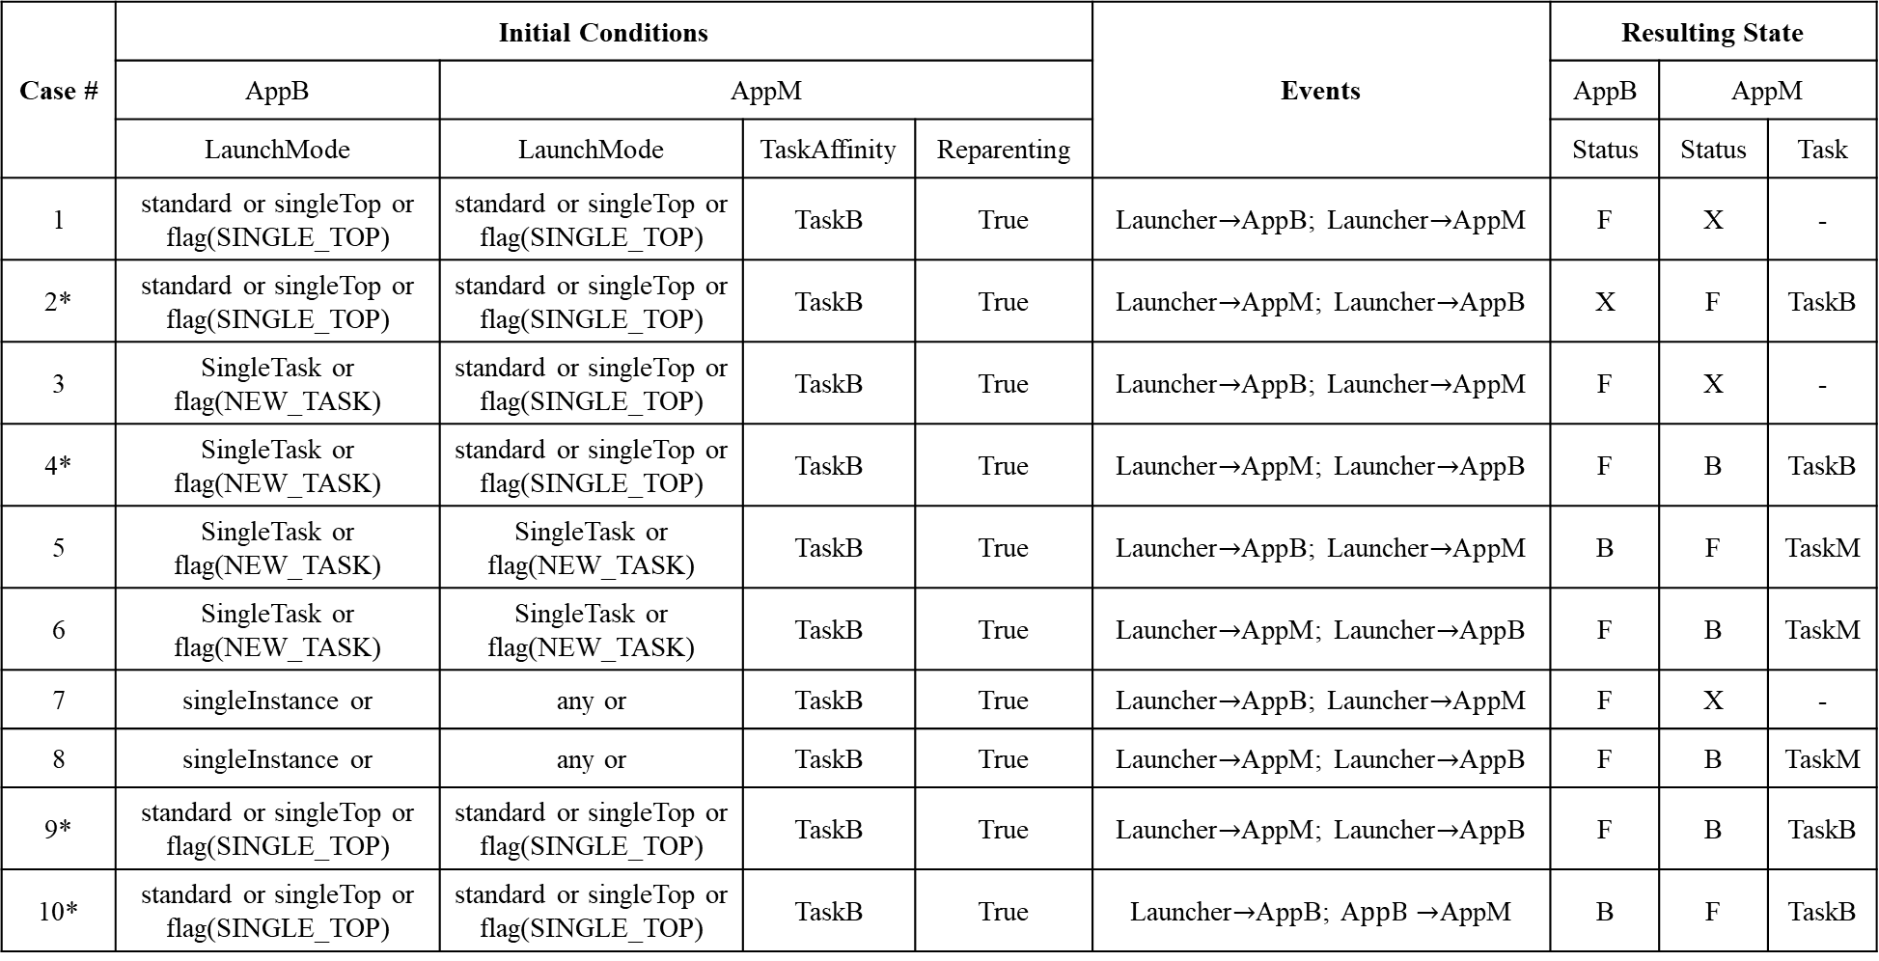
Case # | Initial Conditions |  |  |  | Events | Resulting State
 | AppB | AppM |  |  |  | AppB | AppM
 | LaunchMode | LaunchMode | TaskAffinity | Reparenting |  | Status | Status | Task
1 | standard or singleTop or flag(SINGLE_TOP) | standard or singleTop or flag(SINGLE_TOP) | TaskB | True | Launcher$→$AppB; Launcher$→$AppM | F | X | -
2* | standard or singleTop or flag(SINGLE_TOP) | standard or singleTop or flag(SINGLE_TOP) | TaskB | True | Launcher$→$AppM; Launcher$→$AppB | X | F | TaskB
3 | SingleTask or flag(NEW_TASK) | standard or singleTop or flag(SINGLE_TOP) | TaskB | True | Launcher$→$AppB; Launcher$→$AppM | F | X | -
4* | SingleTask or flag(NEW_TASK) | standard or singleTop or flag(SINGLE_TOP) | TaskB | True | Launcher$→$AppM; Launcher$→$AppB | F | B | TaskB
5 | SingleTask or flag(NEW_TASK) | SingleTask or flag(NEW_TASK) | TaskB | True | Launcher$→$AppB; Launcher$→$AppM | B | F | TaskM
6 | SingleTask or flag(NEW_TASK) | SingleTask or flag(NEW_TASK) | TaskB | True | Launcher$→$AppM; Launcher$→$AppB | F | B | TaskM
7 | singleInstance or | any or | TaskB | True | Launcher$→$AppB; Launcher$→$AppM | F | X | -
8 | singleInstance or | any or | TaskB | True | Launcher$→$AppM; Launcher$→$AppB | F | B | TaskM
9* | standard or singleTop or flag(SINGLE_TOP) | standard or singleTop or flag(SINGLE_TOP) | TaskB | True | Launcher$→$AppM; Launcher$→$AppB | F | B | TaskB
10* | standard or singleTop or flag(SINGLE_TOP) | standard or singleTop or flag(SINGLE_TOP) | TaskB | True | Launcher$→$AppB; A$ppB→$AppM | B | F | TaskB

Slide 22
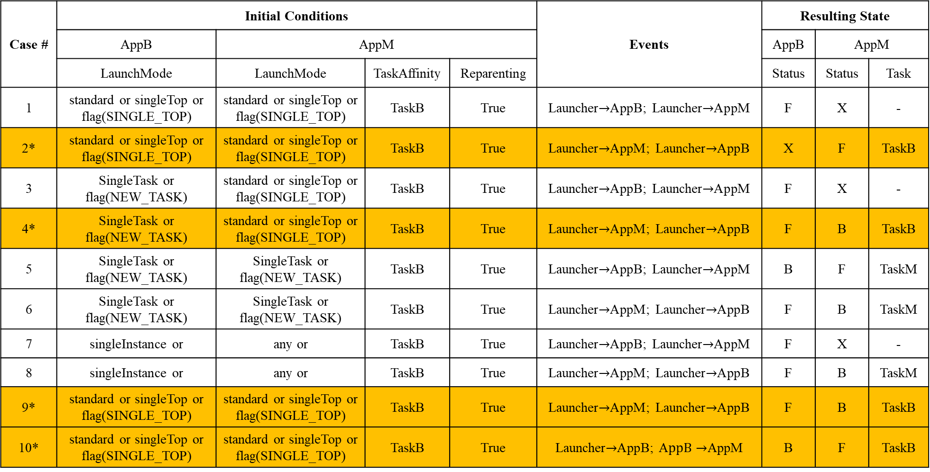
Case # | Initial Conditions |  |  |  | Events | Resulting State
 | AppB | AppM |  |  |  | AppB | AppM
 | LaunchMode | LaunchMode | TaskAffinity | Reparenting |  | Status | Status | Task
1 | standard or singleTop or flag(SINGLE_TOP) | standard or singleTop or flag(SINGLE_TOP) | TaskB | True | Launcher$→$AppB; Launcher$→$AppM | F | X | -
2* | standard or singleTop or flag(SINGLE_TOP) | standard or singleTop or flag(SINGLE_TOP) | TaskB | True | Launcher$→$AppM; Launcher$→$AppB | X | F | TaskB
3 | SingleTask or flag(NEW_TASK) | standard or singleTop or flag(SINGLE_TOP) | TaskB | True | Launcher$→$AppB; Launcher$→$AppM | F | X | -
4* | SingleTask or flag(NEW_TASK) | standard or singleTop or flag(SINGLE_TOP) | TaskB | True | Launcher$→$AppM; Launcher$→$AppB | F | B | TaskB
5 | SingleTask or flag(NEW_TASK) | SingleTask or flag(NEW_TASK) | TaskB | True | Launcher$→$AppB; Launcher$→$AppM | B | F | TaskM
6 | SingleTask or flag(NEW_TASK) | SingleTask or flag(NEW_TASK) | TaskB | True | Launcher$→$AppM; Launcher$→$AppB | F | B | TaskM
7 | singleInstance or | any or | TaskB | True | Launcher$→$AppB; Launcher$→$AppM | F | X | -
8 | singleInstance or | any or | TaskB | True | Launcher$→$AppM; Launcher$→$AppB | F | B | TaskM
9* | standard or singleTop or flag(SINGLE_TOP) | standard or singleTop or flag(SINGLE_TOP) | TaskB | True | Launcher$→$AppM; Launcher$→$AppB | F | B | TaskB
10* | standard or singleTop or flag(SINGLE_TOP) | standard or singleTop or flag(SINGLE_TOP) | TaskB | True | Launcher$→$AppB; A$ppB→$AppM | B | F | TaskB

Slide 23
M2: Understanding Task Privilege
Privilege obtained through Android Task Mechanism
Changing states of other apps in the same task
UI Injection startActivity()
UI Termination finishAndRemoveTask()
Retrieving information of other apps in the same task
Current Foreground Info getRunningTasks()

Slide 24
M3: Exploitation Analysis
We have implemented four PoC attacks exploiting the Task Mechanism and privilege leakage APIs
UI Phishing
Activity-in-the-middle Attack
Gallery Stealing
Screen Shot Capturing
Except Gallery Stealing attack which requires READ_EXTERNAL_STORAGE permission, all other attacks only requires INTERNET permission.

Slide 25
Facebook SP
UI Phishing Attack
Mal SP
Username
Password
Username
Password
Instagram
Mal App
ID@facebook
ID@facebook
*********
*********
Facebook
Back Stack
https://www.youtube.com/watch?v=YJJ3EUS_O_I

Slide 26
Activity-in-the-middle Attack
Facebook SP
Mal SP
Auth
Token
Token
Instagram
Transparent
Activity
Transparent
Activity
Mal App
ID@facebook
*********
Facebook
Back Stack
https://www.youtube.com/watch?v=mxlHzCjddnw

Slide 27
Other Attack Cases
Gallery Stealing
Screen Shot Capturing
Malicious app resides in Instagram’s Task
Monitors if Instagram requests for READ_EXTERNAL_STORAGE
Malicious app injects permission request making the process less suspicious.
Malicious app resides in Facebook’s Task
Monitors if User in LoginActivity
Malicious app continuously take screenshots to steal user’s Facebook username and password
https://www.youtube.com/watch?v=r6KT9JrkIGw
https://www.youtube.com/watch?v=h6OZgPhlNJY

Slide 28
M4: Task Interference Checking
Our goal is to alarm user for potential task violation before an app is installed.
With the knowledge our task interference table, for an new incoming app, we check the App task setting,

Slide 29
Task Interference Checking System
App₁
TICK
App₂
1.Pre-processing
2.Interference checking
Suspicious?
…
Protected App Signatures
Task Interference Table
…
App_{i}

Slide 30
I Know Your Social Network Accounts: A Novel Attack Architecture for Device-Identity Association

Slide 31
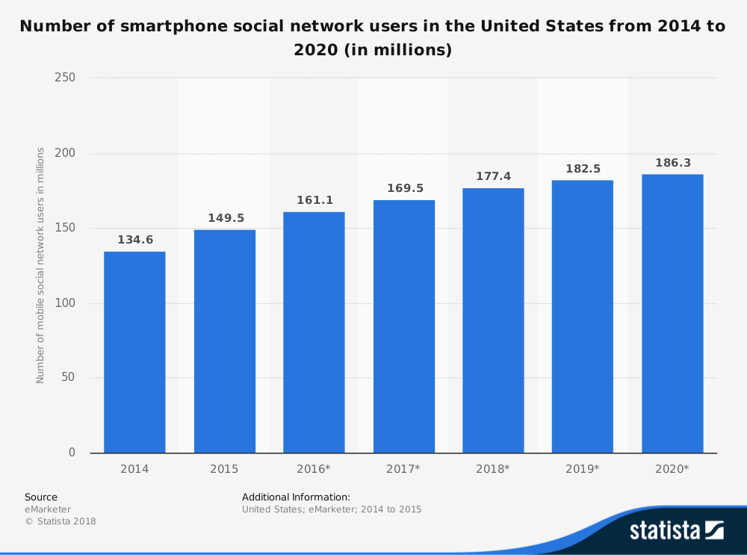









Mobile Social Networking
Mobile social networking (MSN) is social networking where individuals with similar interests converse and connect with one another through their mobile phone.
https://www-statista-com.proxygw.wrlc.org/statistics/238636/number-of-mobile-social-network-users-in-the-us/

Slide 32
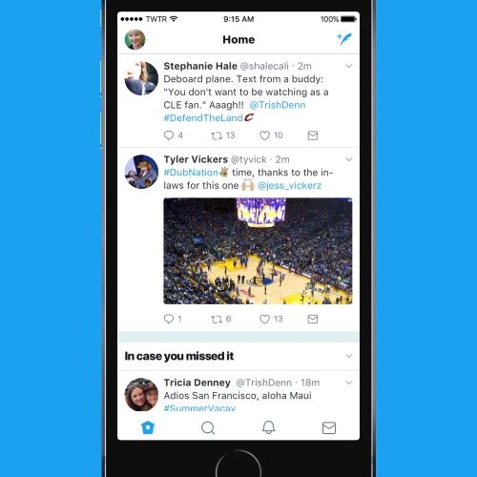

Security Concerns?
Changes of Android Side Channels
Identity of MSN?
The Answer is YES

Slide 33
The Work of Zhou et al. [CCS2013]
TCP payload sequence
(420|150,314,580-720)
TLS Client Hello, TLS session, Client Key Exchange
Time of Tweet
BSSIDs of surrounding hotspots
Location of Tweet
Twitter Database

Slide 34
Limitations of [CCS2013]
TCP payload sequence of tweeting in current Twitter App no long has a fixed pattern.
Twitter combines tweets with one TLS header
The success rate of using BSSIDs of surrounding hotspots is low
Lacking sufficient hotspots
Location with large population has too many candidates to match
Notes:
Yet, their work has two main limitations

Slide 35
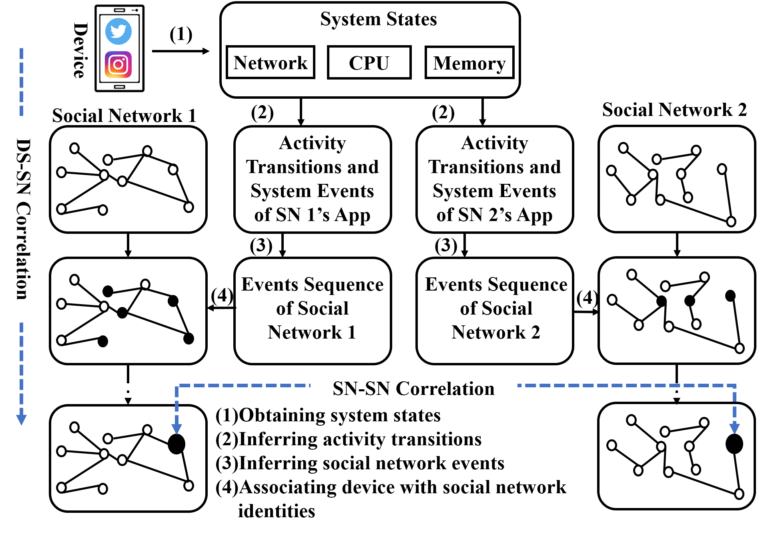
Our Improved Approach

Slide 36
DS-SN Correlation: Android Side Channels
Side-Channel Types | Detailed Values | Physical Meanings | Access Methods
Memory | Virtual Set Size | Total virtual memory of a process | Debug.MemoryInfo /proc/pid/statm “top” and “ps” command /system/xbin/procrank
 | Resident Set Size | Total physical memory of a process
 | Proportional Set Size | Memory shared
 | Unique Set Size | The set of pages of a process
CPU Usages | CPU Usage Rate | The total percentage of time a CPU operates on a running process | /proc/pid/stat “top” and “ps” command
 | User Time | The CPU time spent in the user code of a process
 | System Time | The CPU time spent in the system code
Network Data | Tcp_snd | The number of total sent TCP packets | getUidRxBytes /proc/uid stat/pid/tcp_snd and /proc/uid/stat/pid/tcp_rcv
 | Tcp_rcv | The number of total received TCP packets

Slide 37
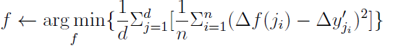
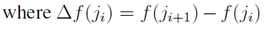
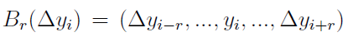
DS-SN Correlation: Memory Regression Algorithm
Use a neural network to model the slopes of Activity transition pattern.
Given a series of memories, calculate vector of slopes of target VSS
Calculate the MSE between the target VSS and the pattern with sliding window
If then we say there is a match with the target Activity Transition.

Slide 38
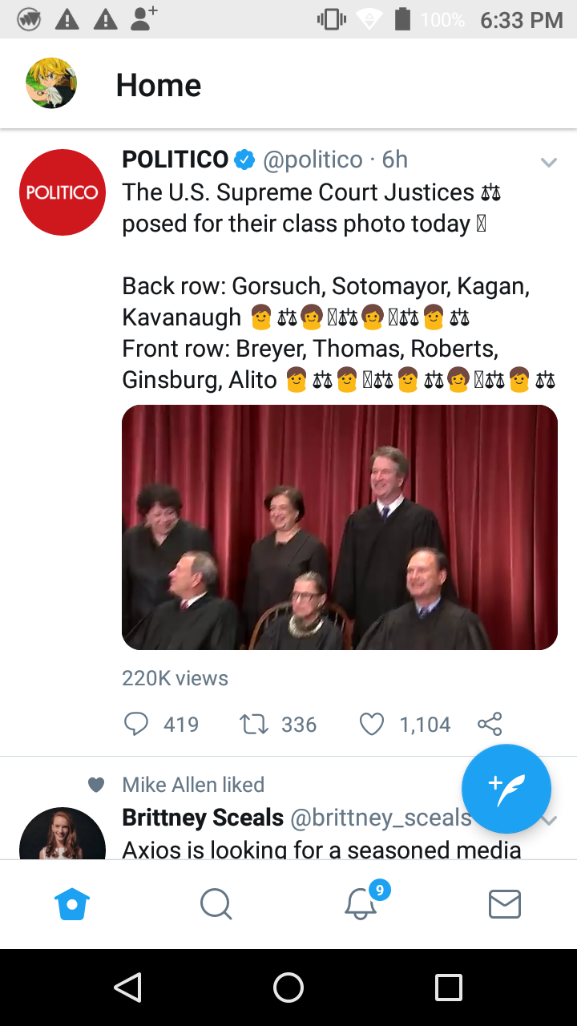
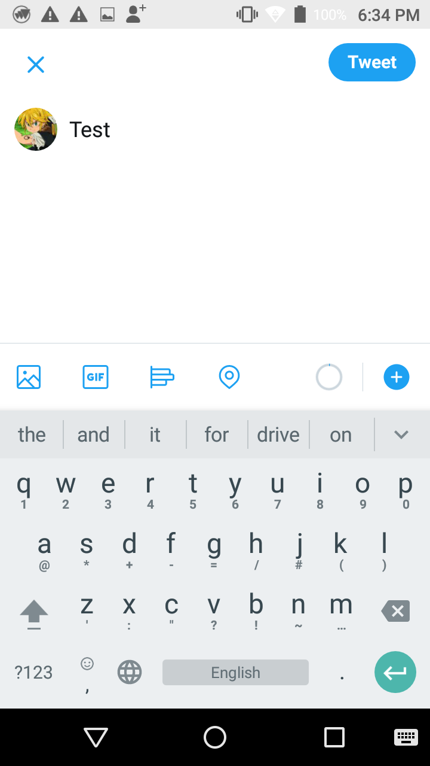

DS-SN Correlation: Inference of Social Network Events
MainActivity
ComposerActivity
VSS of Twitter matches with pattern
tcp_snd
tcp_rcv
VSS of Keyboard
(utime of keyboard + stime of keyboard)/2 number of characters typed

Slide 39

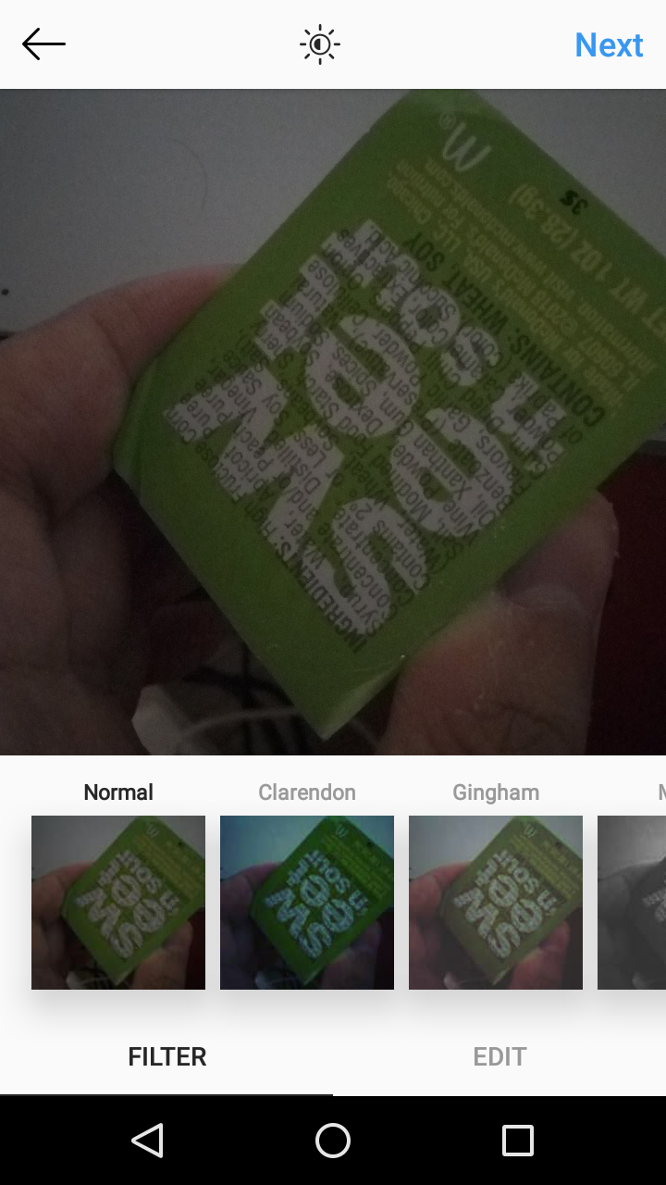
DS-SN Correlation: Inference of Social Network Events
MediaCaptureActivity I
MediaCaptureActivity II
VSS of Instagram matches with pattern
tcp_snd
tcp_rcv
VSS of Keyboard
RSS of android.process.media

Slide 40
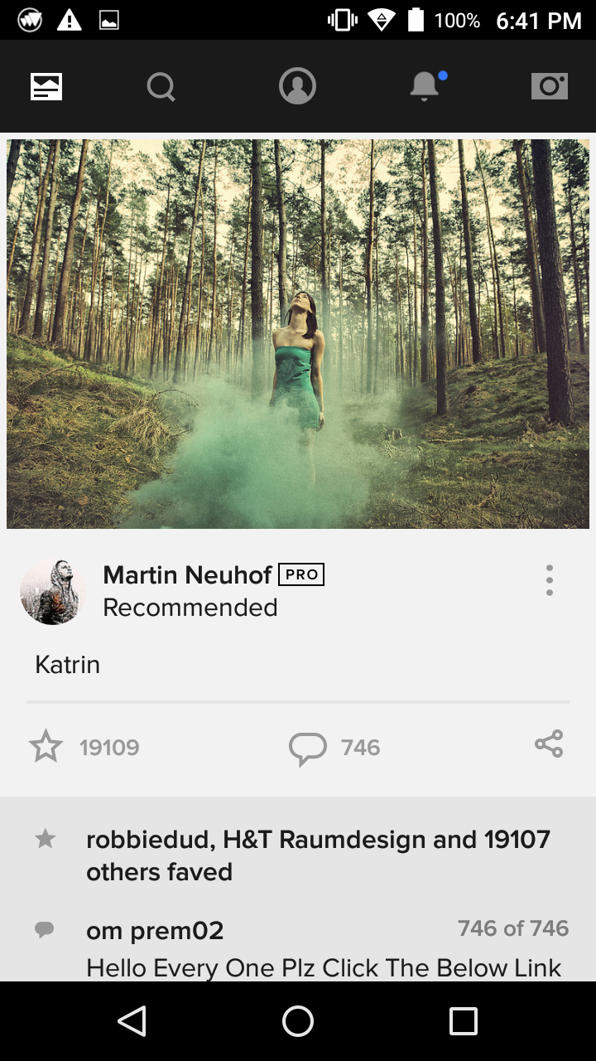
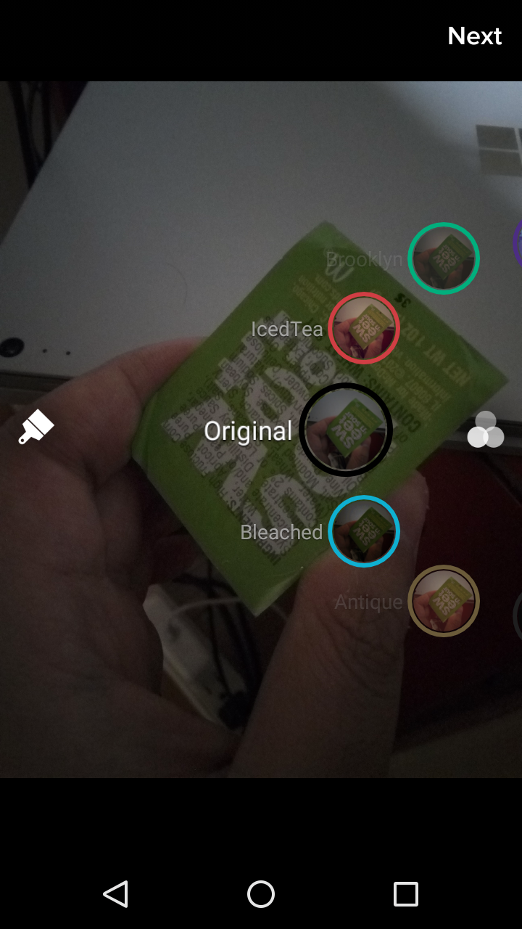
DS-SN Correlation: Inference of Social Network Events
MainActivity
FilterUploadActivity
VSS of Flickr
tcp_snd
tcp_rcv
VSS of Keyboard
RSS of android.process.media

Slide 41
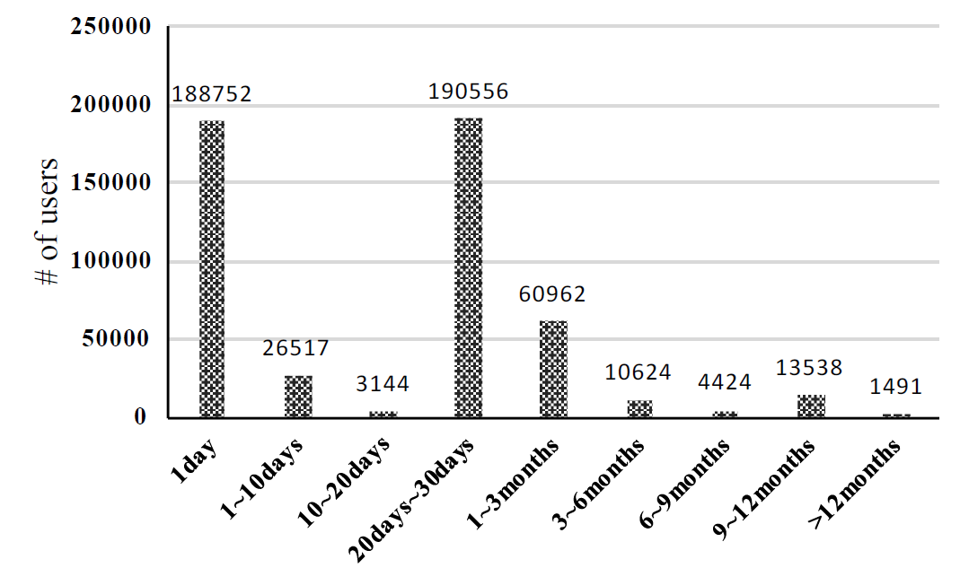
Observation
Many users tweet more than 20 days after the last tweet
Need other schemes to improve the performance: SN-SN Correlation
The number of users vs. the time difference between two successive tweets

Slide 42
SN-SN Correlation
The average person now has 7.6 active social media accounts, with 98% of people having at least one social network account.
Users tend to have similar attributes across different MSNs.
Define attribute similarities to automatically match users across different MSNs.
https://www.marketingtechnews.net/news/2017/nov/17/average-person-has-7-social-media-accounts/

Slide 43
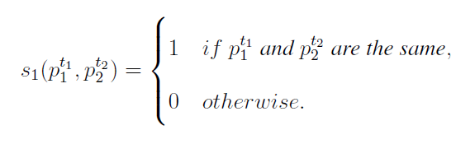
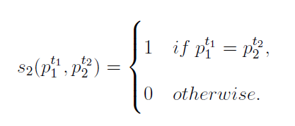
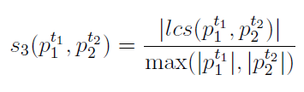
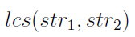
SN-SN Correlation: Attribute Similarity Metrics
Location Similarity:
Personal Website Link Similarity:
Username Similarity: where denotes
the longest common substring str1 and str2.

Slide 44
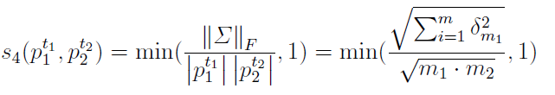
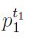
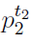
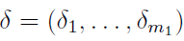
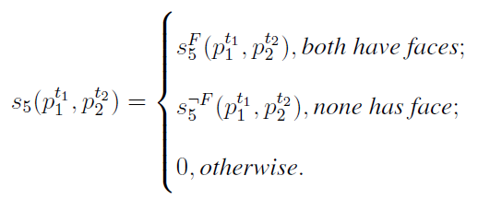
SN-SN Correlation: Attribute Similarity Metrics
Biography Similarity: adopt latent semantic analysis (LSA) in NLP
where m1 and m2 are unique words to and respectively. is the singular value vector of the product of F and F transpose, where F is the frequency matrix in which the ith element means the the number of times the ith word of appearing in .
Profile Image Similarity:
FaceNet [CVPR2015]
SIFT Feature

Slide 45
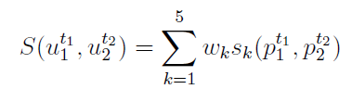
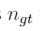
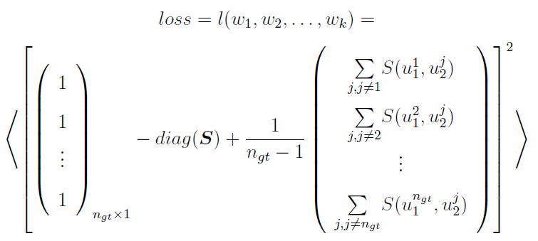
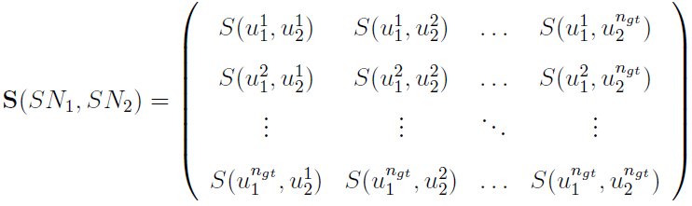
SN-SN Correlation: Attribute Similarity Metrics
The overall similarity between two user accounts in two different MSNs:
Obtain users from SN1 and SN2 as ground truth dataset.

Slide 46
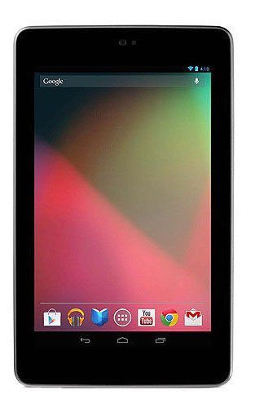


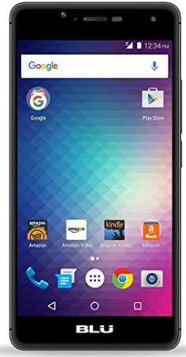
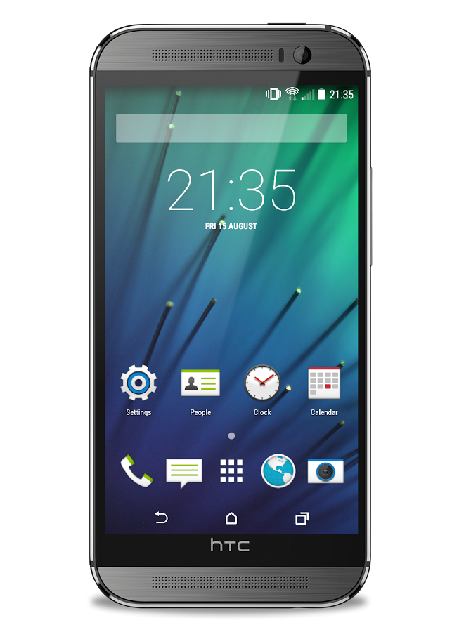
Experiment Setup
Blu R1 HD
Android 6.0
HTC One Sense 6
Android 5.0.2
Samsung Galaxy S4
Android 4.2.2
Huawei Honor 8 Lite
Android 7.0
Google Nexus 7
Android 6.0.1

Slide 47
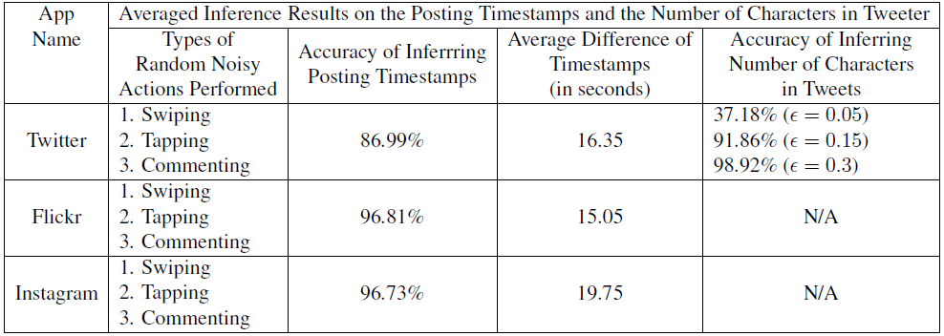
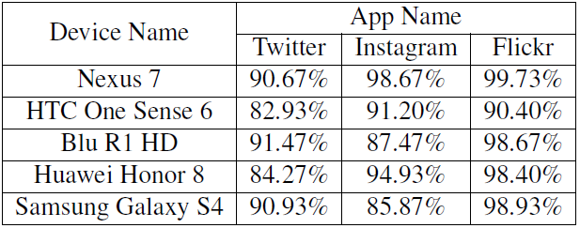
DS-SN Performance: Inference of SN Events

Slide 48
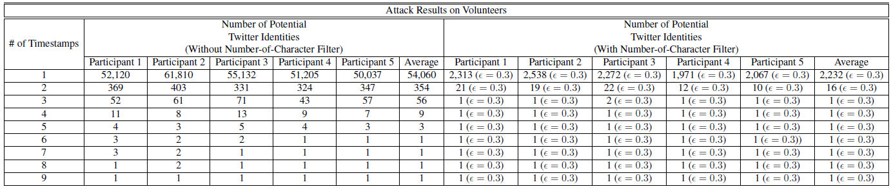
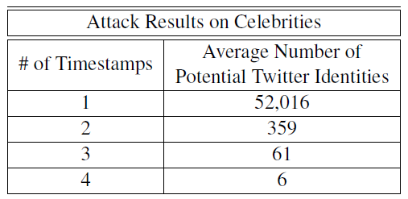
DS-SN Performance: Identity Correlation

Slide 49
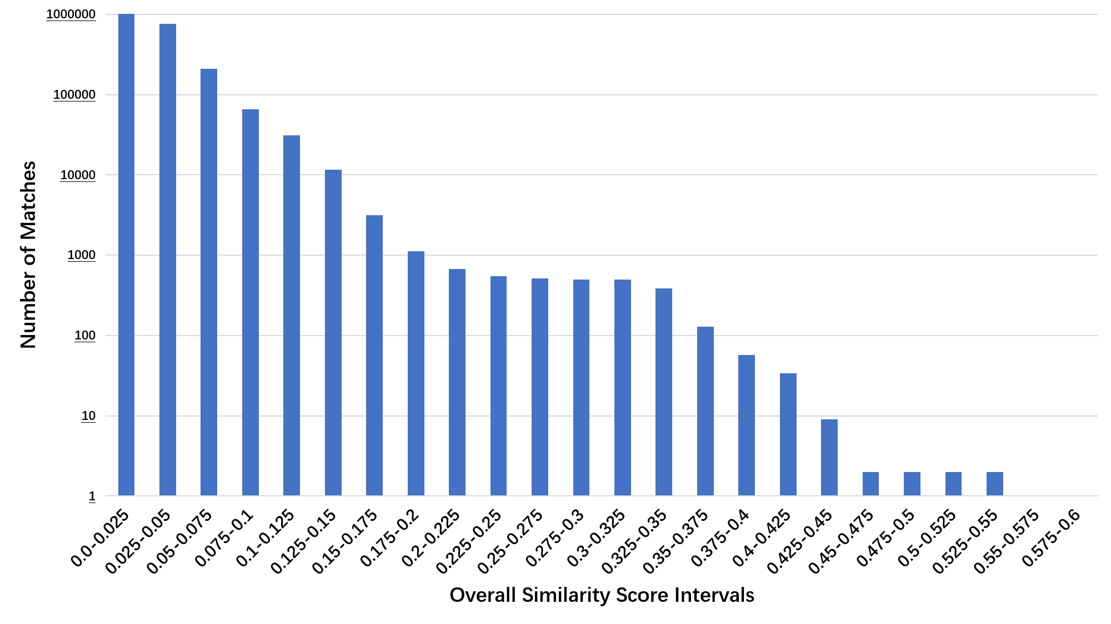
SN-SN Performance:
SN-SN Correlation for the 5th participant, performed with Twitter and Flickr.
Totally 1,112,188 entries (2,198 × 506)
Notes:
More results can be referred to my proposal

Slide 50
CONTENTS
02
03
04
01
Background
Smartphone
Security & Privacy
Smart Home Devices
Security & Privacy
Conclusion

Slide 51



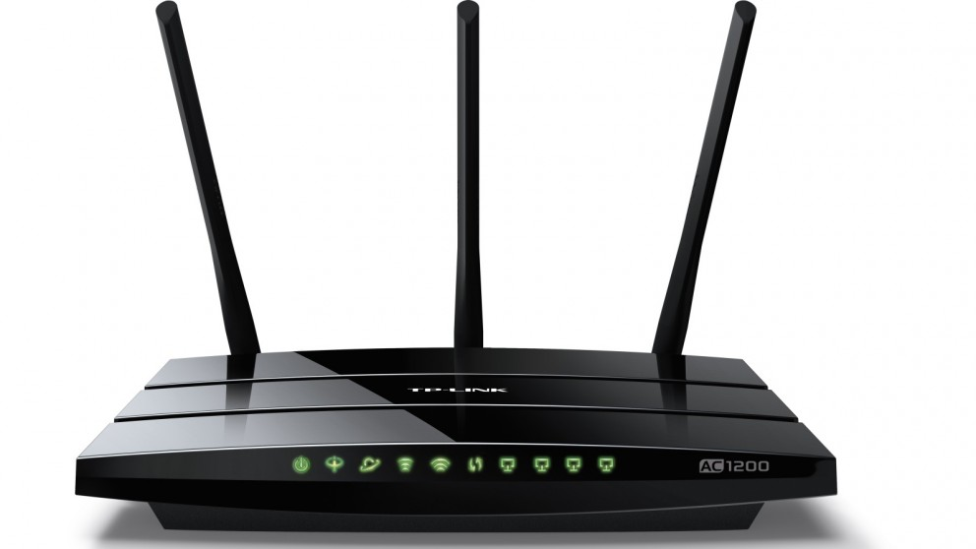
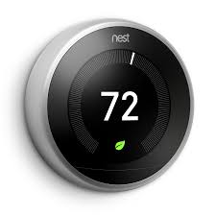





A Typical Smart Home System
IFTTT Platforms
3
2
2
1
1
2
LAN
3

Slide 52

Security Concern #1 Open-Port Attacks
Industry: Mirai (weak credentials), IoTReaper, Hajime (0day vulnerabilities)
Academic: [Jia et al. INFOCOM18’]
IFTTT Platforms
LAN

Slide 53
Security Concern #2 Overprivileged Apps
IFTTT Platforms
[Fernandes et al. SP16’]
[Tian et al. USENIX17’]
[Jia et al. NDSS17’]
[Celik et al. USENIX18’]
LAN

Slide 54
Privacy Concern #3 Dishonest Server Vendors
IFTTT Platforms
LAN

Slide 55
Privacy Concern #3 Dishonest Server Vendors
IFTTT Platforms
LAN

Slide 56

Privacy Concern #3 Dishonest Server Vendors
IFTTT Platforms
LAN

Slide 57

Defense Discussion
IFTTT Platforms
[Tian et al. USENIX17’]
[Jia et al. NDSS17’]
[Celik et al. USENIX18’]
LAN

Slide 58
Defense Discussion
IFTTT Platforms
LAN

Slide 59
CLAF: A Credential-Less Authentication Framework for Smart Home Systems

Slide 60






















CLAF Workflow – Three Examples
Smartphone
Smart Home Server
Remote Attacker
Router
$${op}_{j1}$$
Light-Control App
$${op}_{j1}$$
$${op}_{j3}$$
Policy
Cache
Evidence
Cache
Policy Server
$$e_{j1}$$
Synchronize
policy
P = {p₁ p₂,…};
p_{i} = ($c_{i}^{p}$, ${op}_{i}^{p}$, $h_{i}^{p}$)
Evidence Provider
$$e_{j2}$$
$${op}_{j2}$$
Operation Handler
$${op}_{j1}$$
$${op}_{j2}$$
$c_{j2}={ c}_{i2}^{p}$ AND${ op}_{j2}$ $≠$ ${ op}_{i2}^{p}$AND $h_{j2}≠{ h}_{i2}^{p}$
$c_{j1}={ c}_{i1}^{p}$ AND ${op}_{j1}$= ${ op}_{i1}^{p}$AND $h_{j1}={ h}_{i1}^{p}$
$c_{j3}≠{ c}_{i3}^{p}$ AND${ op}_{j3}$ $≠$ ${ op}_{i3}^{p}$AND $h_{j3}≠{ h}_{i3}^{p}$
Smart Coffee Machine App
$${op}_{j3}$$
Drop
Smart Light Bulb
Smart Switch

Slide 61

CLAF Implementation and Evaluation
Implementation
Evidence Provider:
Running on a user’s smartphone
Infer if the target smart home app sends an op based on VSS and tcp_snd.
Infer if a user interaction exists based on accelerometer and light sensor data.
Operation Handler:
Running on the router
Intercepting traffics through iptable and ARP spoofing
Policy Server:
Implemented on Samsung SmartThings Platform with Restful API
Evaluation Results
Effectiveness:
2,763 out of 2,800 (98.68%) attack trials were inhibited under the real smart home system
5,315 out of 5,480 (96.99%) attack trials were inhibited targeting SmartApps.
600 out of 600 (100%) attack trials launched by Mirai and its variants were inhibited.
Overhead:
Less than 1 second latency

Slide 62
Defense Discussion
IFTTT Platforms
LAN

Slide 63
CaRF: A Capability-Based RTOS Framework for CPS Embedded Devices

Slide 64













Overall Architecture of the Framework
User-Level Thread
Kernel
Super User’s credentials
Communication
Module
NSEM
CAM
CUM
$$C_{1}$$
$$C_{2}$$
RTOS
$$C_{3}$$
…
C $=(ID,T,A,B,E)$
$$C_{n}$$
A $=(S, O)$
Capability Table
BSP
SOM
CSFS
HAL
Non-Secure
Region
Secure Region
MCU Inner Structure

Slide 65

Defending Against Attacks

Slide 66
Two Implementations of the Framework
Adopting Memory Protection Unit (MPU) as a hardware isolation mechanism
Enable MPU to set the sensitive memory regions to be NO_ACCESS
Only the FreeRTOS privileged kernel can modify the MPU setting
The communication module is hosted by a unprivileged FreeRTOS thread.
Privileged requests from the unprivileged thread has to be submitted to the processor-level supervisor call (SVC) interrupt service routine (ISR) for further analysis.
Adopting TrustZone (TZ) as a hardware isolation mechanism
Separate OS Kernel into secure kernel an non-secure kernel using Secure Attribution Unit (SAU)
Secure kernel hosts all the sensitive functions and data (NSEM, CAM, CUM, CSFS)
Non-secure kernel hosts all the risky functions and data (communication module)
NSEM is realized using Non-Secure Callable (NSC) with SG instruction.

Slide 67






MPU-Based Implementation (STM32f767)
SVC ISR
Transfer
Super User’s credentials
CAM
Taint Data Cleansing
$$C_{1}$$
Ethernet
Module
$$C_{2}$$
$$C_{3}$$
Configure MPU Access
CUM
…
$$C_{n}$$
Unprivileged
FreeRTOS
Thread
Capability Table
Capability Table
FreeRTOS Kernel
APROM
Page #1
APROM
Page #2
SOM
MPU Protection Enabled

Slide 68
TrustZone-Based Implementation (Nuvuton-M2351)
NSC
Transfer
Super User’s credentials
CAM
$$C_{1}$$
ESP8266
WiFi
Module
Taint Data Cleansing
(Optional)
$$C_{2}$$
$$C_{3}$$
CUM
…
$$C_{n}$$
Non-Secure
FreeRTOS
Kernel
Capability Table
Capability Table
APROM
Page #1
APROM
Page #2
Secure Kernel
SOM
Secure Kernel

Slide 69
Evaluation
Security Performance:
Open-Port Attacks
Weak-Authentication Attacks (Mirai, etc)
0-day Attacks (Hajime, IoTReaper, etc)
Overprivileged Attacks
4 overprivileged attacks created by [Fernandes et al. SP16’]
10 overprivileged SmartApps created by [Jia et al. NDSS17’]

Slide 70
CONTENTS
02
03
04
01
Background
Smartphone
Security & Privacy
Smart Home Devices
Security & Privacy
Conclusion

Slide 71
Conclusion
Mobile and smart home devices have been prevailing in recent years.
The security and privacy conditions are not satisfying.
We demonstrated an attack targeting Android system and proposed a defense solution to it.
We demonstrated the attacks targeting a smart home system and proposed a credential-less authentication framework and capability-based RTOS for smart home systems.

Slide 72
Thank You!

